Slide 1

- Presentation -

Slide 2





Who is BTS?
More Fabulous than Kimchi and Psy (Gangnam Style)
2017 and 2018 Billboard Music Awards BBMAs - Top Social Artist
The group's 2018 album, LOVE YOURSELF 轉 'Tear', debuted at No. 1 on the Billboard200
and No. 10 on the BillboardHOT100 , marking the highest rank as Asian artist in history
Current No.1 in Social 50 chart (https://www.billboard.com/charts/social-50)

Slide 3

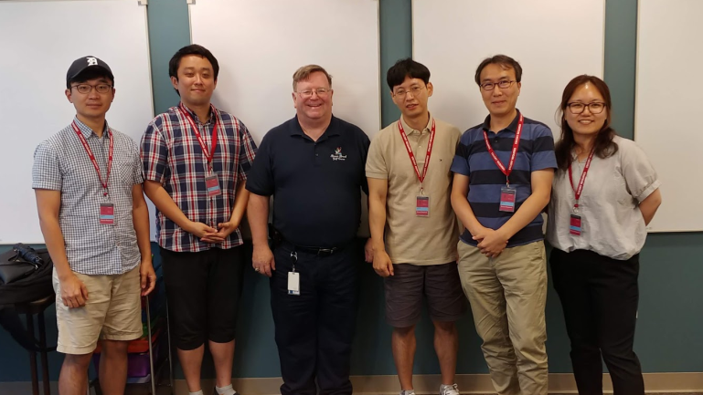
Team introductions
Team Goal
“Understanding of SDET Culture and Techniques”,
not dancing or singing like BTS.
Team member / Main Role
Clifford C Huff / Mentor
Sungho Chin / Team & Project Lead
Jonggoo Lee / Code Review Lead
Sujung Lyu / Refactoring Lead
Jinhyeok Yang / Static Analysis Lead
Hyoyeon Hwang / Plan & Test Lead
Ground Rules
Every member should be involved in every quality management process.
5 h for project / day, 1 Project Meeting / day, 1 Mentoring Meeting / week

Slide 4
Project introductions
Project Goal
Making Bug-free Game. (at least No Major, Critical defects)
Applying experience in this project to LG project
Quality Goals
Discussion of collected data : team Wiki, JIRA, Sonar, GitHub
 |  | Goal | Result | Status
Testability | Line coverage | 90% | 84%
 | Branch coverage | 80% | 67%
 | Mutation coverage | 90% | 71.3%
Function’s Logical Correctness | Unit Test – Pass Rate | 100% | 100%
Function’s suitability for new features | new features development rate | 60% | 100%
※
※ partially applied

Slide 5
Project Risk Management
Project Risk
Technical Risk
- Unclear Requirements made implementation and source modification difficult
➔ Modify and add requirements to clarify
- Different proficiency of Java language among individual
➔ Assign job by individual skill level
Resource Risk
- Lack of time to implement all new features
➔ Separate members into developers and testers based on their specialty
- Limitation of LG internal development Tool
➔ Using external JIRA tools that team members feel familiar
Product Risk
- Many unintended errors occurred during the integration of new functions
➔ Simultaneously execute integration test and system test

Slide 6

Tools
CI : Github + Jenkins (http://18.210.196.163:8080)+ sonaQube
Source Repository : github (https://github.com/sunghochin/TartanAdventure)
Quality Tool : SonarQube (http://18.210.196.163:9000/projects)
Document Configuration : Wiki page (https://sdet-bts.atlassian.net/wiki/spaces/SDET/overview)
Issue tracker : Jira (https://sdet-bts.atlassian.net/secure/RapidBoard.jspa?projectKey=SDET&rapidView=1)
Coverage library : JaCoCo, PITest
Auto trigger build
Static analysis
build
Coverage integration
source commit
Measure coverage

Slide 7
Quality activities
Code Review
Team (Technical) Review
Static Analysis
SonarQube
Refactoring & Rework
SonarQube, Eclipse
Unit Test / Mutation Test
White Box testing (statement testing, branch testing)
JUnit4, Mockito, JaCoCo, PITest
Integration Test
Scenario testing (Black box testing)
JUnit4, Mockito, JaCoCo
System Test
Scenario testing, Combination testing, Boundary Value Analysis
Ad-hoc testing

Slide 8
Project Plan

Slide 9

Project efforts
Efforts for Project
Planned effort : initial planned effort(h) for our project (420 h)
Estimated effort : estimated effort(h) for each task by assignee (401.2 h)
Actual effort : actual executed effort(h) for each task (410.4 h)

Slide 10
Project Results - Defect Categorization
Definition of Severity
Severity | Category | Defect Types
Critical | Functionality | Conflict to requirements
 | Reliability | Critical unstable issue. (can't proceed game)
Major | Maintainability | Structural Odd Code (no consistency with other code)
 | Maintainability | Static Analysis critical issue
 | Reliability | Memory handling issue
 | Functionality | Strange functional Operation
Minor | All defects except Critical, Major defect
Defects on each stages

Slide 11
Project Results - Defect Categorization
Defects & Efforts
Implications
In Static Analysis, analyzing defect was time-consumed
Intuitive Tests are more effective to detect major, critical defects
We couldn’t detect critical defects about system Robustness by SDET techniques ( e.g. Mutation Test, Modeling Test)

Slide 12
Quality activities - Code Review
Goal
Understanding system of Tartan Adventure
Checking correspondence between Spec. and Code
Detecting Code defects
Resource
Planned Effort (6/21 ~ 26) : 50h (2h * 5days * 5 members)
Actual Effort : 36.5h
Outputs
Defect List
Lessons Learned
Vague requirements made code review hard
Code review is one of good way to understanding System

Slide 13
Quality activities - Static analysis
Goal
To detect defects with less effort than dynamic testing
To integrate static analysis tools to the CI environment
Resource
Planned Effort (7/9 ~ 11) : 15h (1h * 3days * 5 members)
Actual Effort : 10h
Outputs
Defect List
False Alarm List
Lessons Learned
Static analysis results are used as a basic data of refactoring
It helped to manage coding convention and complexity

Slide 14
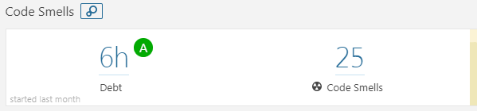
Quality activities - Refactoring & Re-Work
Goal
Improving Testability
Improving Code smells in SonarQube (by 1day debt)
Resource
Planned Effort (7/11 ~ 13) : 30h (2h * 3days * All members)
Actual Effort : 25.3h
Outputs
Refactoring status : Number of refactoring items (69) (ref. appendix.1)
SonarQube Trend
Lessons Learned
Refactoring is indispensable for Testability
Monitoring method for Field Status is needed to know changed status.
- Getter & setter methods are added
Method should return about that’s result of procedure
Notes:
Monitoring method for Field Status is needed to know changed status.
- For this, We discussed for changing private fields to public fields
- Finally, we added getter & setter methods.

Slide 15
Quality activity – Unit Test
Goal
Verify the operation for all functions
Completion Criteria
Unit Test – Pass rate : 100%
Statement Coverage : 90% / Branch Coverage : 80%
Resource
Planned Effort (7/16 ~ 20, 26~27) : 55h (2h * 5.5 days * all members)
Actual Effort : 67.9h
Outputs
Number of Unit Test : 332
Coverage : statement : 84%, branch : 67%
Defect List
Lessons Learned
To effectively write the Unit test, we need a detailed specification
Fewer defects are found as it progresses to code coverage rather than verifying function operation
Notes:
2000line이 늘어서 coverage를 만족하기 힘들었다.
Actual / estimated Effort : 64h/73h
Should simple code be included in the Unit test?
→ Our team's decision: don’t include

Slide 16
Quality activity – Mutation Test
Goal
Satisfying Mutation coverage
Goal Coverage
80% line coverage 80% mutation coverage
Resource
Planned Effort (7/23) : 5h (5 h * 1 member)
Actual Effort (7/23) : 11h
Outputs
Mutation Test Result Report (PITest Summary)
Mutation Coverage : 71.3 % (for Game, Player, Item classes)
Lessons Learned
Improvement of Mutation coverage was not directly related to improvement of Unit Test defect detection
→ selectively handle the remaining test case bugs provided by the PITest
Explicit unit test case implementation of the parts to be checked and the degree of stub processing affected the mutation coverage
Notes:
Estimated Effort : 10h (7/23, 2 members, each 5hours)
Affected Unit Test Case : GameTest.java - 46 , ItemTest - 3, PlayerTest.java - 4
Mutation Coverage : 55 -> 71.3 % (for Game, Player, Item classes)
The purpose of the mutation test is to check the fidelity of the test case.
test case verification of programs that contain a lot of logic to change the value
test case verification of safety-oriented programs (automotive, aviation-related programs, etc.).
예상 질문
유닛테스트 작성을 위해 디테일한 스펙을 정리 했는가?

Slide 17
Quality activity – Integration Test
Goal
Integrate & Verify new features to make them working properly.
Completion criteria
Test Case Pass Rate : 100%
Resource
Planned Effort (7/18~20, 26~30) : 60h (3h * 6days * all members)
Actual Effort : 36.5h
Outputs
Test Case : 18
Pass Rate : 100 %
Defect List
Lessons Learned
In the tartan project, the modules are already integrated, should we do the integration test?
Notes:
New feature integration test case 및 defect 기준으로 수정
New feature 내용 위주로 재구성
기존 내용은 effort. 관련된 데이터 위주로 재사용

Slide 18
Quality activity – System Test
Goals
Verify requirements from the user's perspective
Especially, Use-Cases mainly validated
Completion criteria
Test Case Pass Rate : 100%
Resource
Planned Effort : (7/16~17, 19~25, 30~31) : 80h (5h * 8days * 2 members)
Actual Effort : 41.2h
Outputs
Test Cases : 492
Current Pass Rate : 97.1%
Defect List
Lessons Learned
Ambiguous requirements and unexpected gaming behavior made code review hard
Notes:
Scenario : 29, Action/Item : 434, Game Config. : 29
시나리오 : palyer와 designer의 시나리오 흐름도를 기반으로
시나리오의 시작에서 종료까지 path를 타도록 TC를 생성
Action/Item : 게임 진행시 필요한 세부 동작에 대한 test case. 모든 아이템(29개)의 action(14)을 실행하고, 추가로 item 없는 action에 대해서도 test하기 위한 tc 생성
Game Config. : designer의 시나리오과 관련 있음. 디자이너가 만든 게임의 valid 를 check 하는것에 대한 세부 TestCase를 분리한것.

Slide 19
Quality activity – Overall Effort
Implications
Actually code review was done in other stages also.
We thought that Spec. based Testing (Integration and System Tests) were more efficient.
→Resources between Actual and Planned efforts were spent to develop
new features

Slide 20
New Feature Architecture
Msgs & cmds
msgs & cmds for offline
New modules
msgs & cmds for online
user
Game Config Json
Game Config Json
Game Config Json
Offline
User
online
User
Tartan Terminal
Socket
Game
Process
Custom Game
System.in & out
Tartan Server
System.out
System.in
User DB
Socket
Socket
User Management
Socket
Game
Game
Tartan Client
Player
Save Json
Save&Load
Player
Game Configuration
Custom Game Configuration
Room
Item
Room
Item
Game Thread

Slide 21





Overall Course Lesson & Learned
I got the idea that quality activities could be
more enjoyable than development
- Sungho chin
I impressed about how Top level SW companies make
effort to ensure SW Quality. Applying valuable
techniques to my work is my homework. - Jonggoo Lee
I learned about various techniques and tools
It seems to be about to lead ‘well’ in collaboration.
- Sujung Lyu
It was nice to be able to study intensively.
I will try to apply various quality techniques
appropriately to actual projects. - Jinhyeok Yang
It was a good experience to work SDET during project.
I will try to apply what I learned in this course
to my work. - Hyoyeon Hwang

Slide 22
Q&A
Thank you for your attention!!

Slide 23
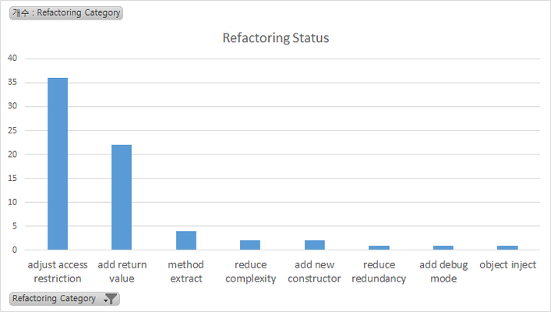
Appendix 1. False Alarm, Refactoring Status
False Alarm from SonarQube
- Replace this use of System.out or System.err by a logger.
- Remove the literal "false" boolean value.
- Define a constant instead of duplicating this literal "interior" 3 times.
- Use isEmpty() to check whether the collection is empty or not.
- Rename this constant name to match the regular expression '^[A-Z][A-Z0-9]*(_[A-Z0-9]+)*$'.
Refactoring Status
Category | num | Graph
adjust access restriction | 36
add return value | 22
method extract | 4
reduce complexity | 2
add new constructor | 2
reduce redundancy | 1
add debug mode | 1
object inject | 1
Notes:
print
if(a==true)
item instance에 대해 중복 data로 분류
List가 비어져 있는지 확인할때 isEmpty() => 우리는 size로 함.
ActionLook.

Slide 24
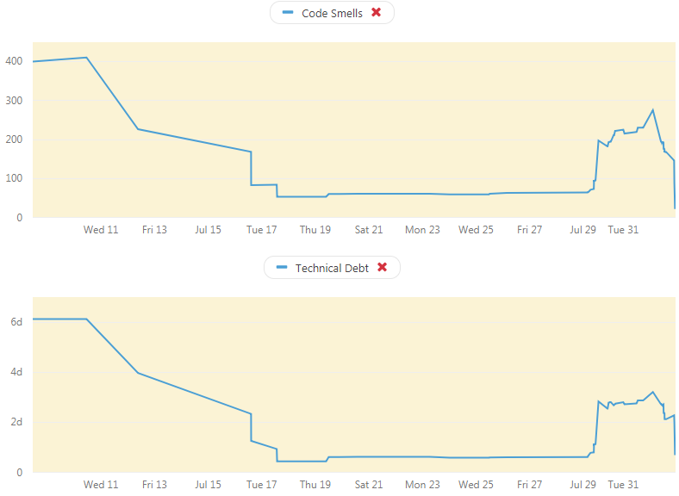
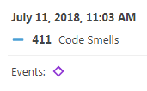
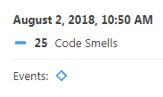
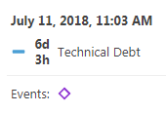
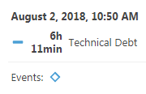
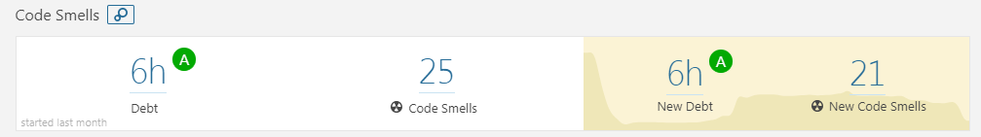
Appendix 2. Refactoring & Re-Work
SonarQube Trend

Slide 25
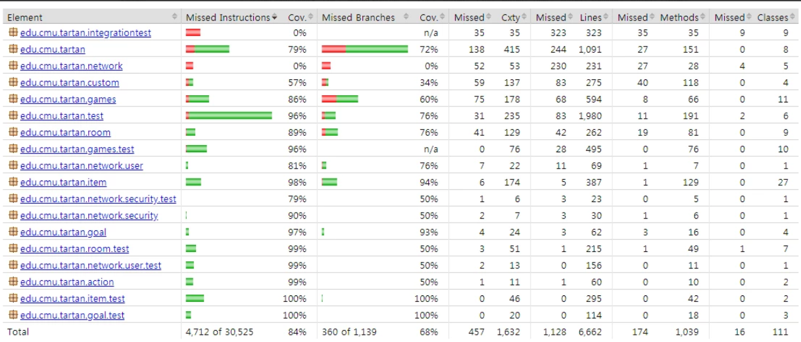
Appendix 3. Quality activity – Unit test
Coverage
Notes:
예상 질문
유닛테스트 작성을 위해 디테일한 스펙을 정리 했는가?

Slide 26
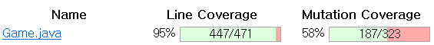
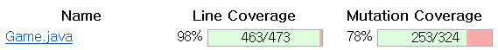
Appendix 4. Mutation Coverage
Before Coverage
After Coverage
Notes:
예상 질문
유닛테스트 작성을 위해 디테일한 스펙을 정리 했는가?

Slide 27
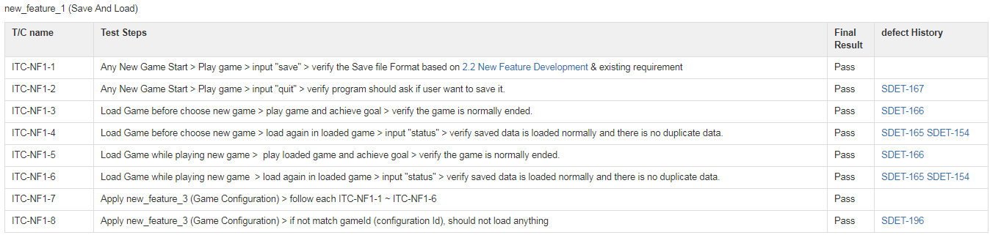
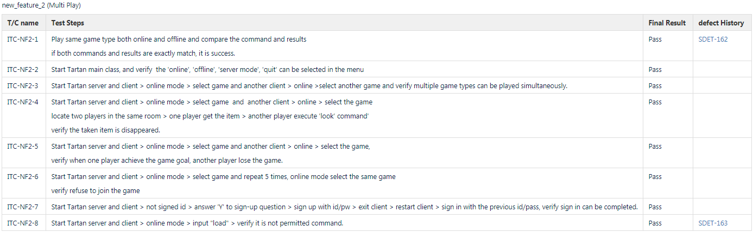
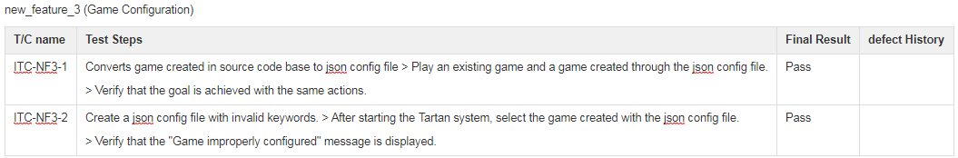
Appendix 5. Integration Test Case
Test case
Notes:
예상 질문

Slide 28
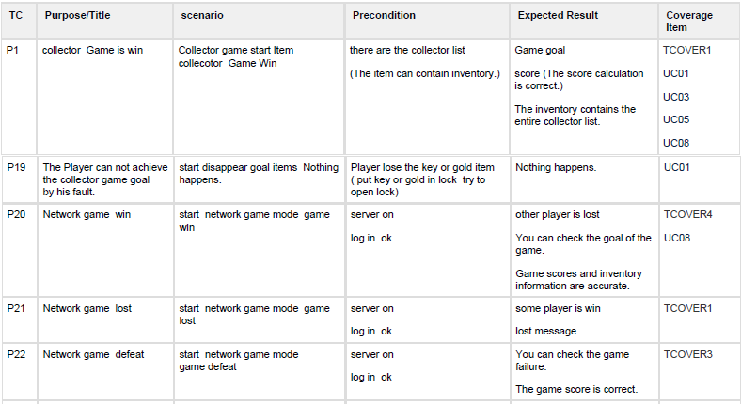
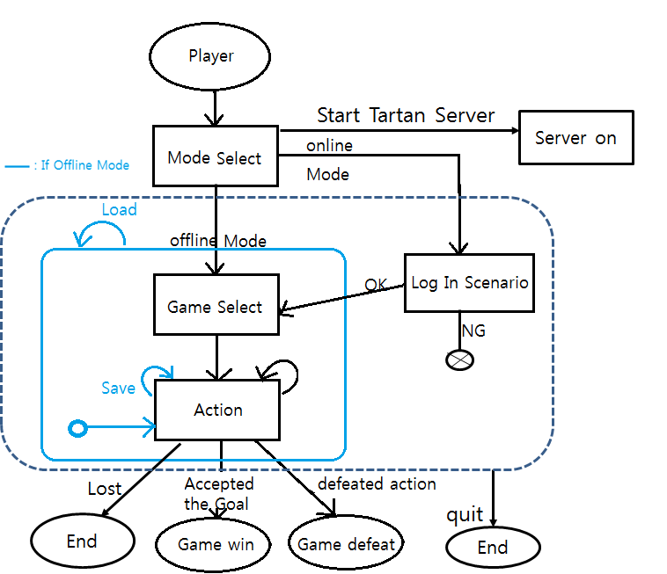
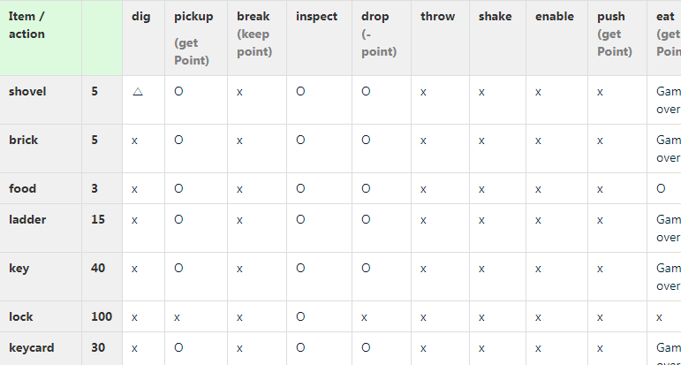
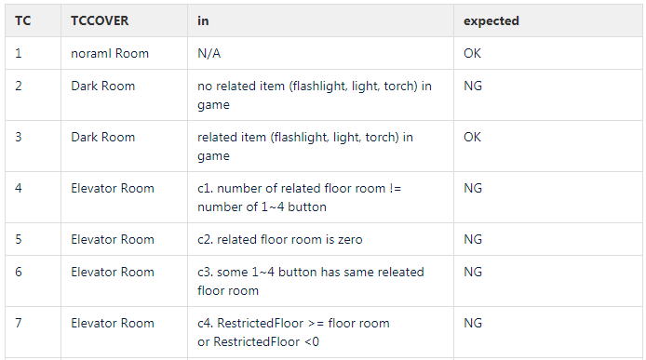
Appendix 6. System Test Case
Scenario
Action & Item
Game Configuration
Notes:
action(29) & Item(14) -> All combination -> 406 T/C

Slide 29
Appendix 6. Unresolved Defects(System Test)
NG Defect - TC List
Issue key | Summary | Priority | covered TC ID
SDET-201 | [Defect] network game - "javax.crypto.IllegalBlockSizeException" error | Critical | tc_uc04
SDET-108 | [Defect] break pot -> score error | Major | tc_p25
SDET-110 | [Defect] remove action error | Major | tc_p8
SDET-121 | [Defect]'eat action' point action diffent | Major | tc_p22
SDET-122 | [Defect] installed item in safe -> remove action -> error status | Major | tc_opensafe
SDET-178 | [Defect] obscured room - obscuringItem : dynamite is not action | Major | tc_detonatedynamite
SDET-194 | [Defect] requirement item room - There are no that item in the inventory. -> action error | Major | tc_removedocumentinsafe
SDET-202 | [Defect] save/load : point cal error - elevator game 6point save -> continue game. 8 point -> load game score 14 | Major | tc_p4, tc_p5
SDET-203 | [Defect] save/load : rooms visit information error. - at load time, current room is in room visited. | Major | tc_p9, tc_digshovel
SDET-90 | [Defect] Darkness Win/Defeat condition & Explore Goal | Major | tc_uc02
SDET-152 | [Defect] pass, "\ n" action in Additional action required item | Minor | tc_cg3
SDET-185 | [Defect] point game -> very large point over game all point -> no error | Minor | tc_openlock
SDET-187 | [Defect] [game config] elevator room -> no button item -> no error | Minor | tc_uc04
SDET-188 | [Defect] _elevatorRestrictedFloor 媛?諛?_elevatorInitialFloor 媛믪씠 ?ㅼ젣 痢?媛믨낵 ?ㅻ쫫 | Minor | tc_p1
SDET-193 | [Defect] game config. : There is an unconnected room. -> no error | Minor | tc_putgoldinlock
Notes:
예상 질문

